Slide 1
Ideas & Scenarios

Slide 2
Smart Windows:
Smart windows will be automatically closed in case of extreme weather or rain. This is can be user-preference based, the user can set a temperature; depending on which the AC or heater will be automatically activated/ deactivated.
Requirements : Windows, Micro-controller, AC, Wifi.

Slide 3
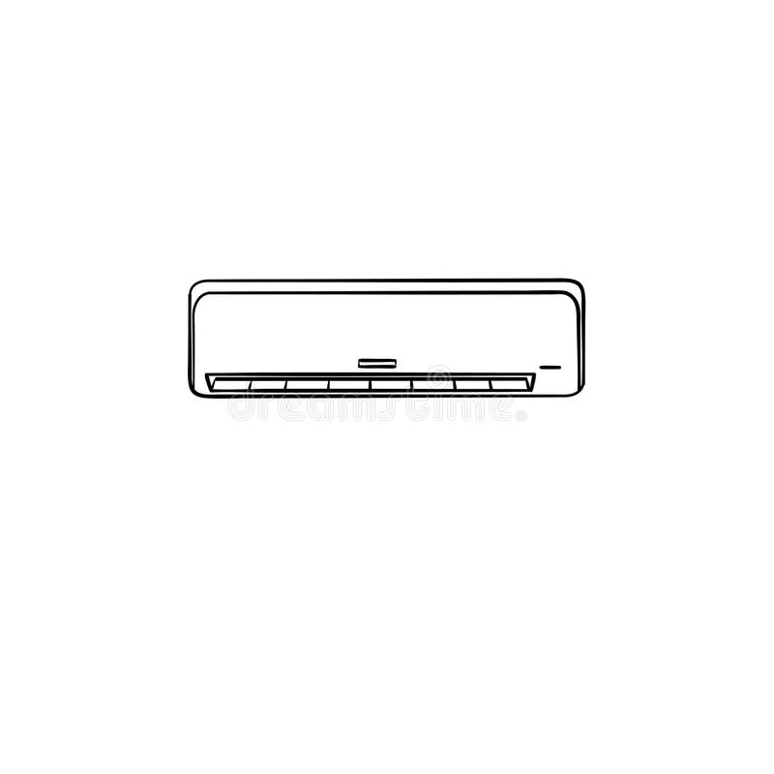

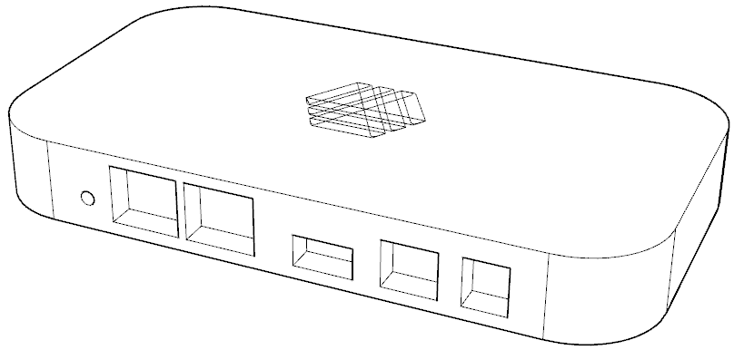
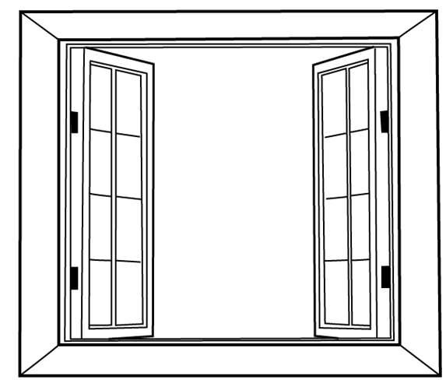
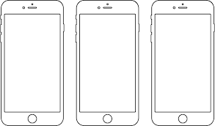

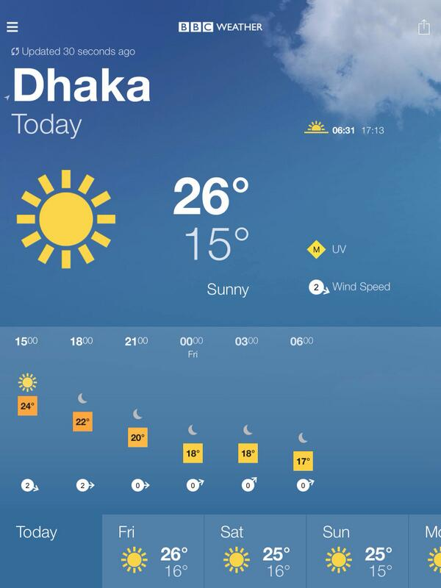

AC Turned off
Smart app showing
the weather is good
Window open

Slide 4
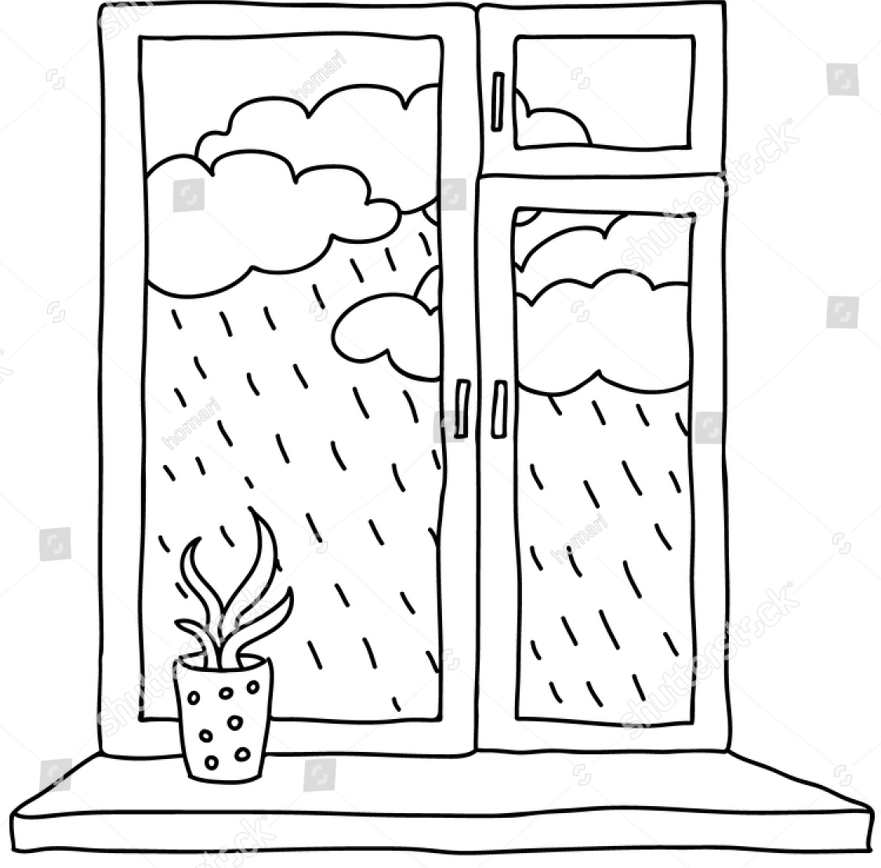
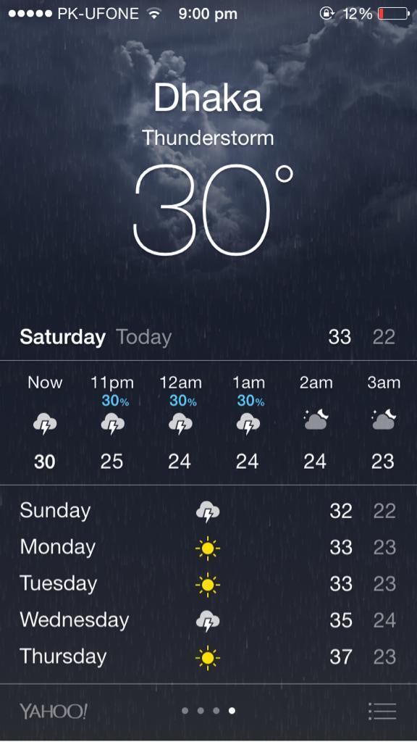
Smart app showing
the weather is rainy
Window automatically closes when the it detects a forecast of rain.

Slide 5
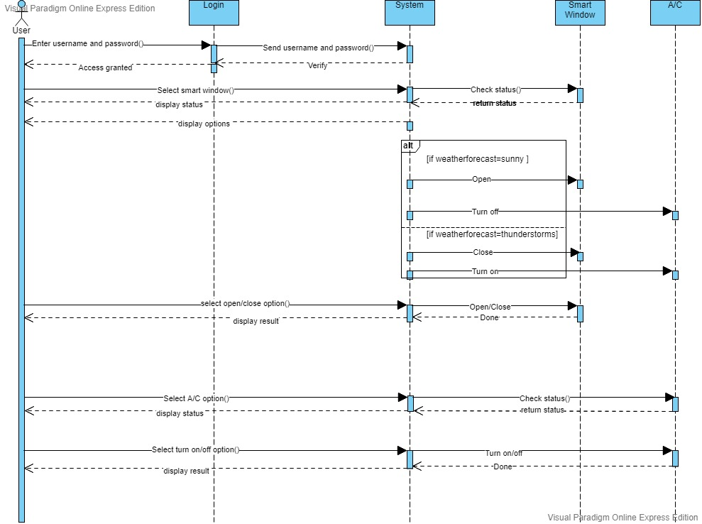
Sequence Diagram

Slide 6
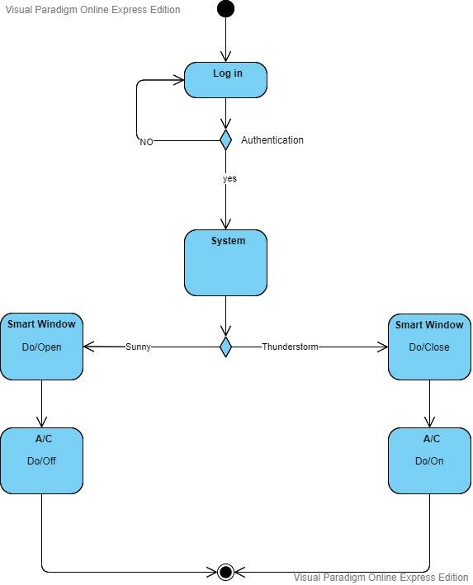
Activity Diagram

Slide 7
Smart Gardening:
A separate space for garden in the house for the plant lovers. The smart home will allow devices like GreenSens to be compatible with it, keeping the user constantly updated about the health of each of the plants in the garden.
Requirements: GreenSens, Space in the house.

Slide 8
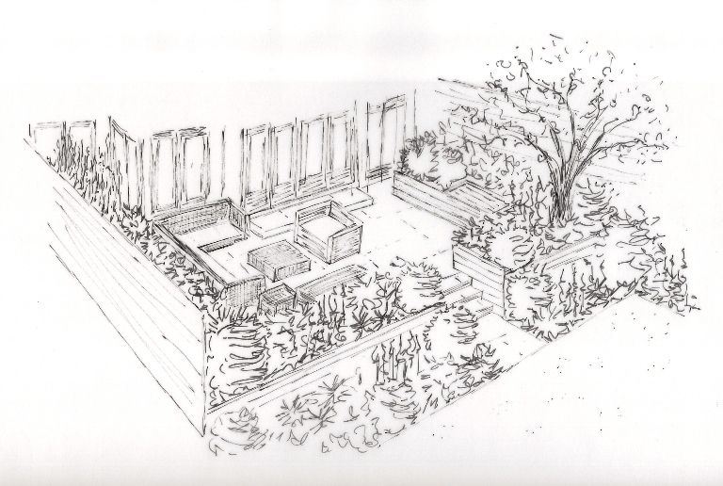
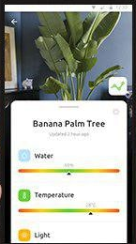
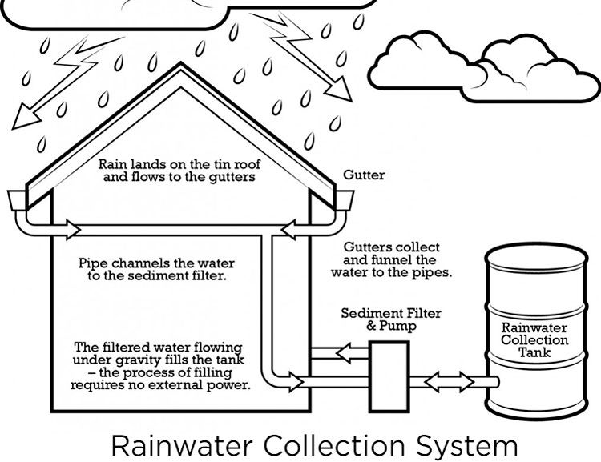
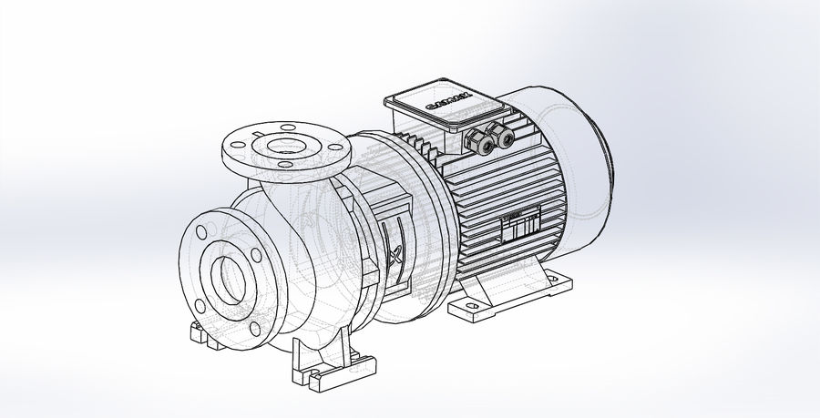
Garden in the terrace and lawn
Smart app showing overall health of plants
When the water level of plants is low, the smart system automatically pumps water to the garden.

Slide 9
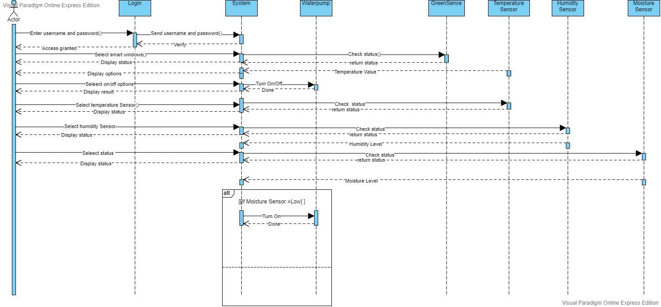
Sequence Diagram

Slide 10
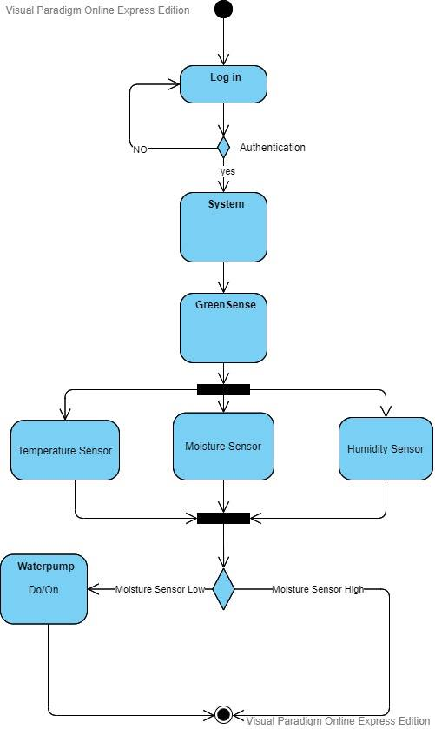
Activity Diagram

Slide 11
Gas Leakage:
Generally in our region, we are highly dependent on gas-controlled stoves. This is, indeed, very dangerous. To make a safer environment in the house, our smart home will include a gas leakage system. This system will generally keep track of gas level in the kitchen vicinity. Once the gas level in the kitchen is more than usual, or out of control, the system will take precautionary measures, such as an alarm system will go off, shutting off the gas flow and on user preference, the windows might open.
Requirements: Gas sensor, alarm system, Micro-controller.

Slide 12

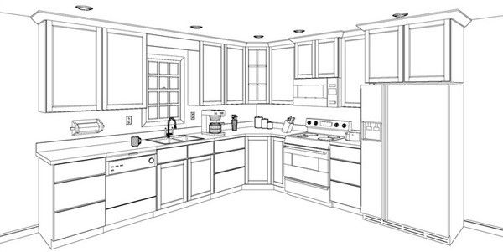
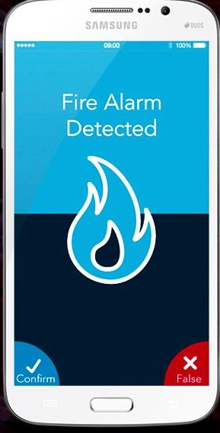
Gas sensors
Fire alarm
Gas level in the kitchen is too high, sending off an alarm and notifications in the app.

Slide 13
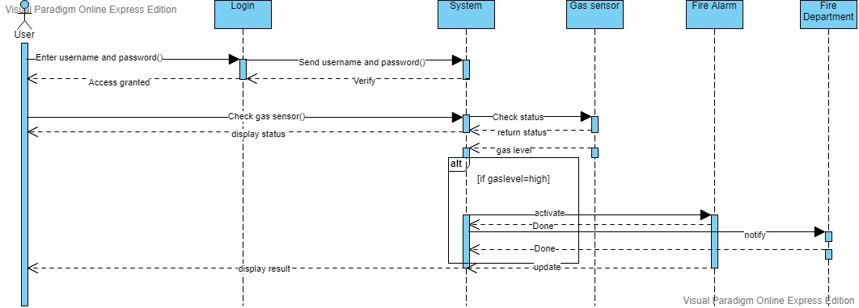
Sequence Diagram

Slide 14
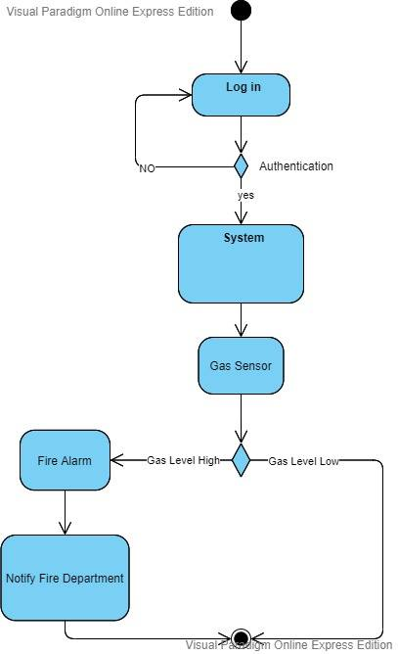
Activity Diagram

Slide 15
Rain water-recycling system:
Luckily, our region has rainy seasons. While this is a real problem, but can also be used to our benefits. Our smart home can store the excess rain water by strategical planning throughout the house, and recycle them; e.g. by purifiying the water or use them in the smart gardening system.
Requirements: Water reservoirs, filter system, waterpumps.

Slide 16
Garden
Primary reservoir water level is low
Primary reservoir

Slide 17
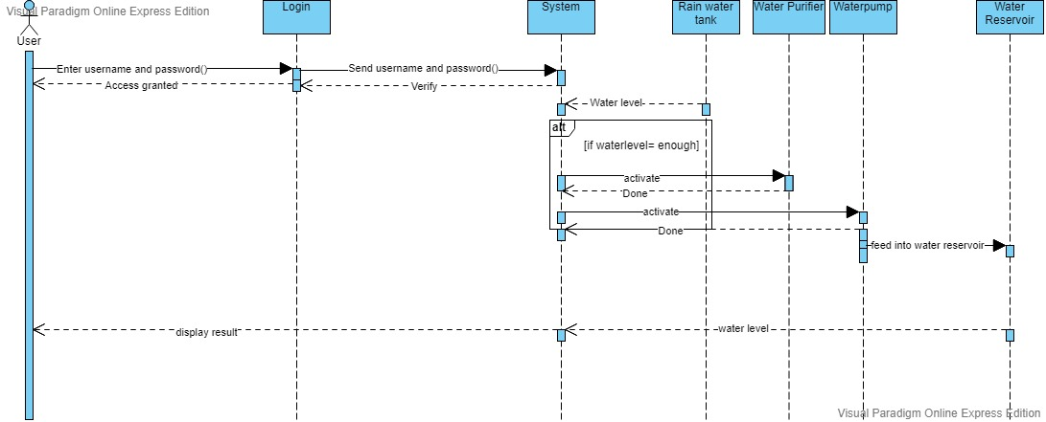
Sequence Diagram

Slide 18
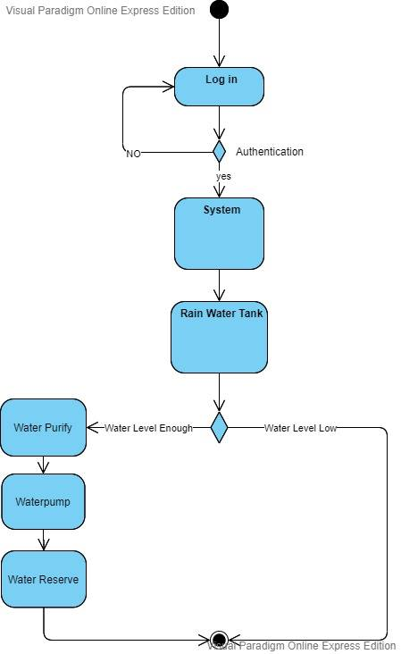
Activity Diagram

Slide 19
Voltage stabilizers:
Power outage is a real problem in our region, and hence the supply of stable voltages. Since the smart home is electricity-dependent, this is a huge problem. To tackle this, we can integrate stabilizers in our smart home systems to ensure a stable supply of voltages to our electrical appliances. When the stabilizer is not able to handle high voltages, it will send a notification to the user. Requirements: Stabilizers.

Slide 20

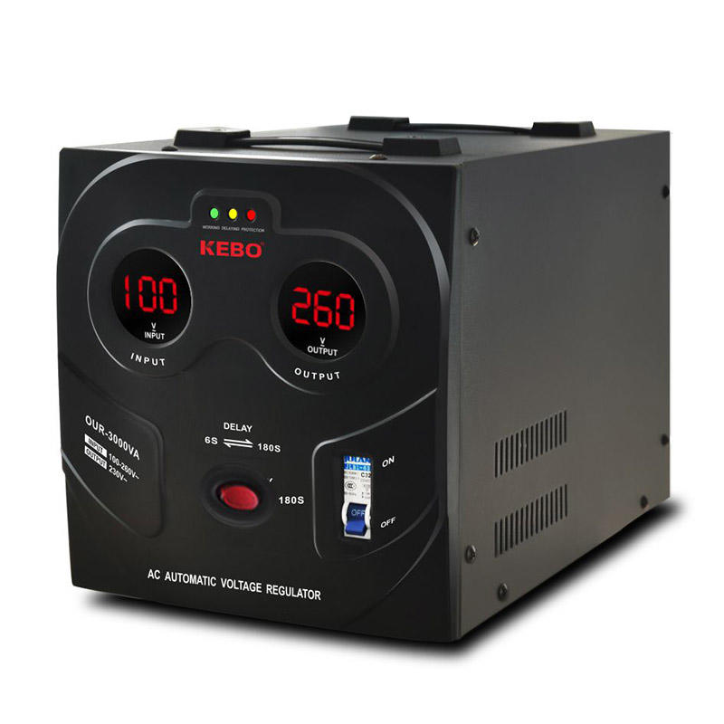
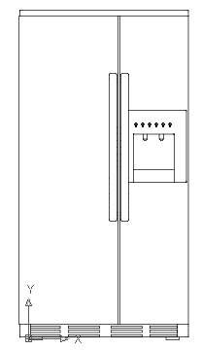
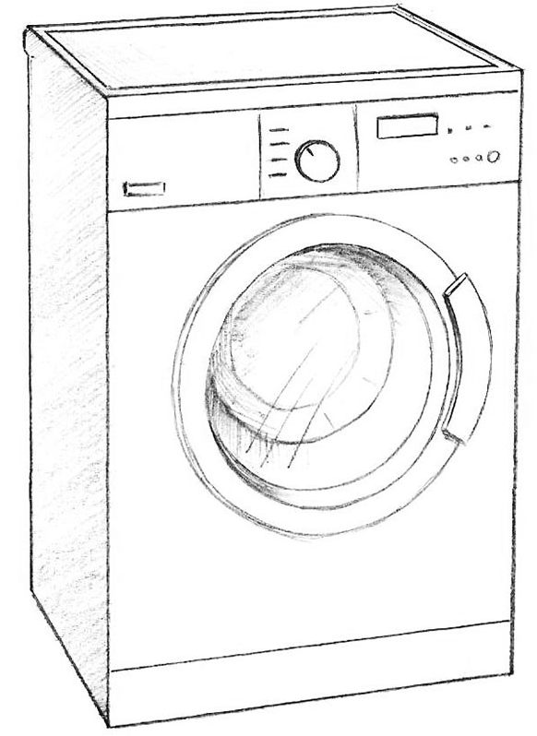
Stabilizer is functioning

Slide 21
Insect Repellers:
Our region is also very prone to insects, especially mosquitoes. Our smart home will include a central system to kill insects, or drive them away. This can be controlled by activating some insect-repelling devices and closing the windows at specific times of a day to keep the insects at bay.
Requirements: Ultrasonic pest repellent.

Slide 22
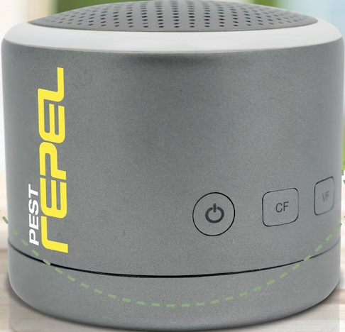
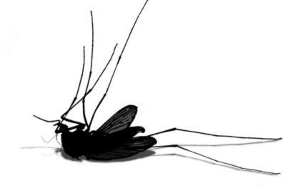
Pest Repel is fucntioning
Pest Repel controlled by the hub

Slide 23
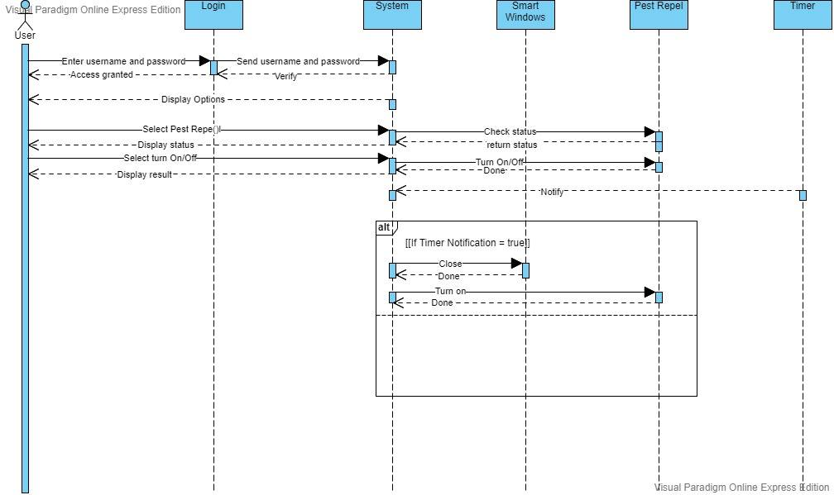
Sequence Diagram

Slide 24
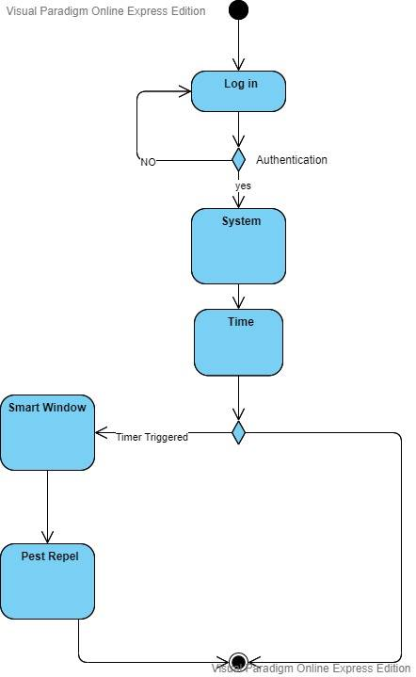
Activity Diagram

Slide 25
Lightning Rods:
Lightnings are a common phenomenon in our region. In fact, very few houses have precautions to this. So as a precaution, we can use lightning rods to direct the lightning to the ground. So, the smart system can activate the lightning rod, when it can foresee thunderstorms. Requirements: Smart ESE lightning rod (ESE28)

Slide 26
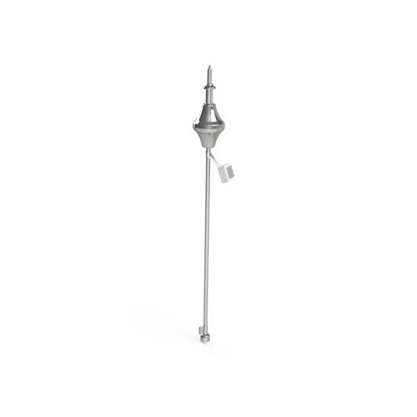
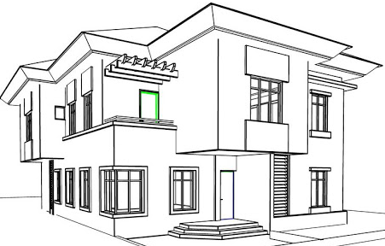
Lightning Rod
Lightning rod activated when it foresees thunderstorm.

Slide 27
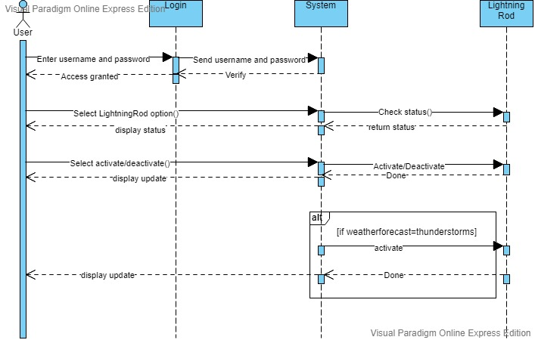
Sequence Diagram

Slide 28
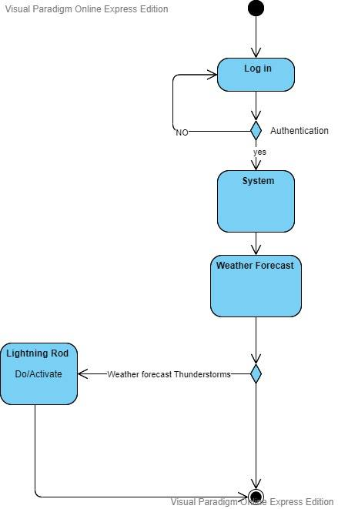
Activity Diagram

Slide 29
Class Diagram For Smart Home System

Slide 30
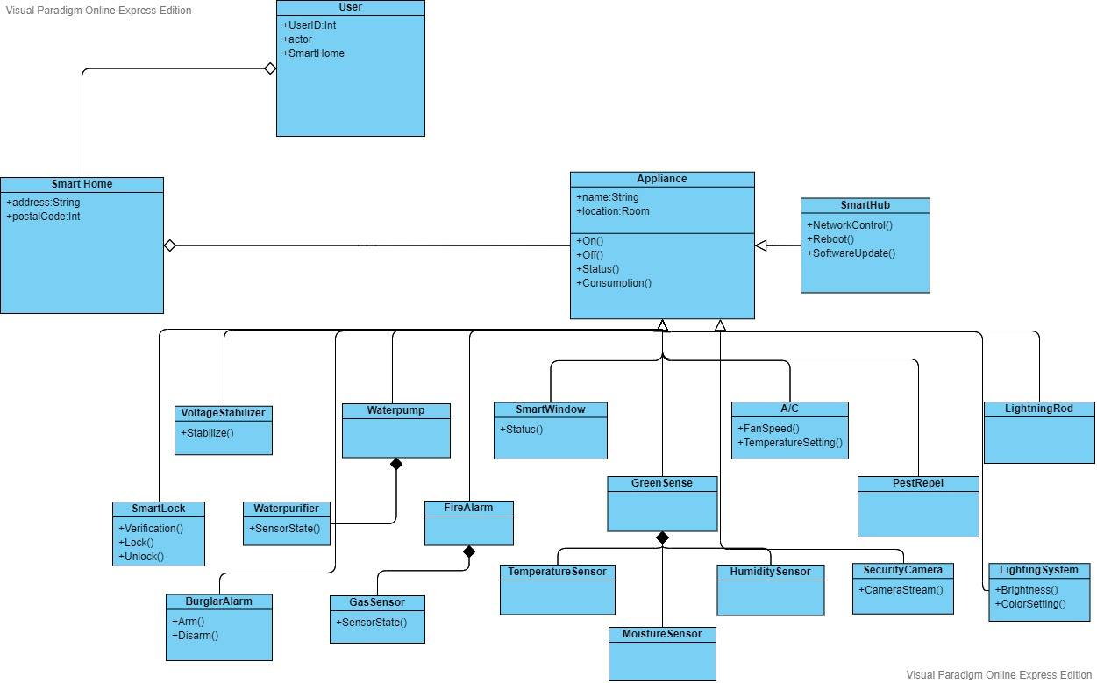

Slide 31
Use-Case Diagram For Smart Home System

Slide 32
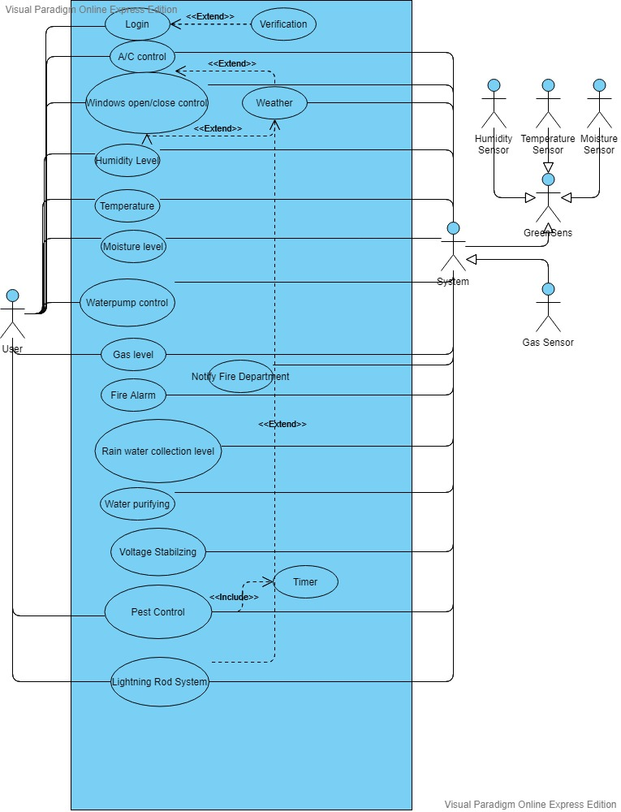

Slide 33
Sequence Diagram For Smart Home System

Slide 34
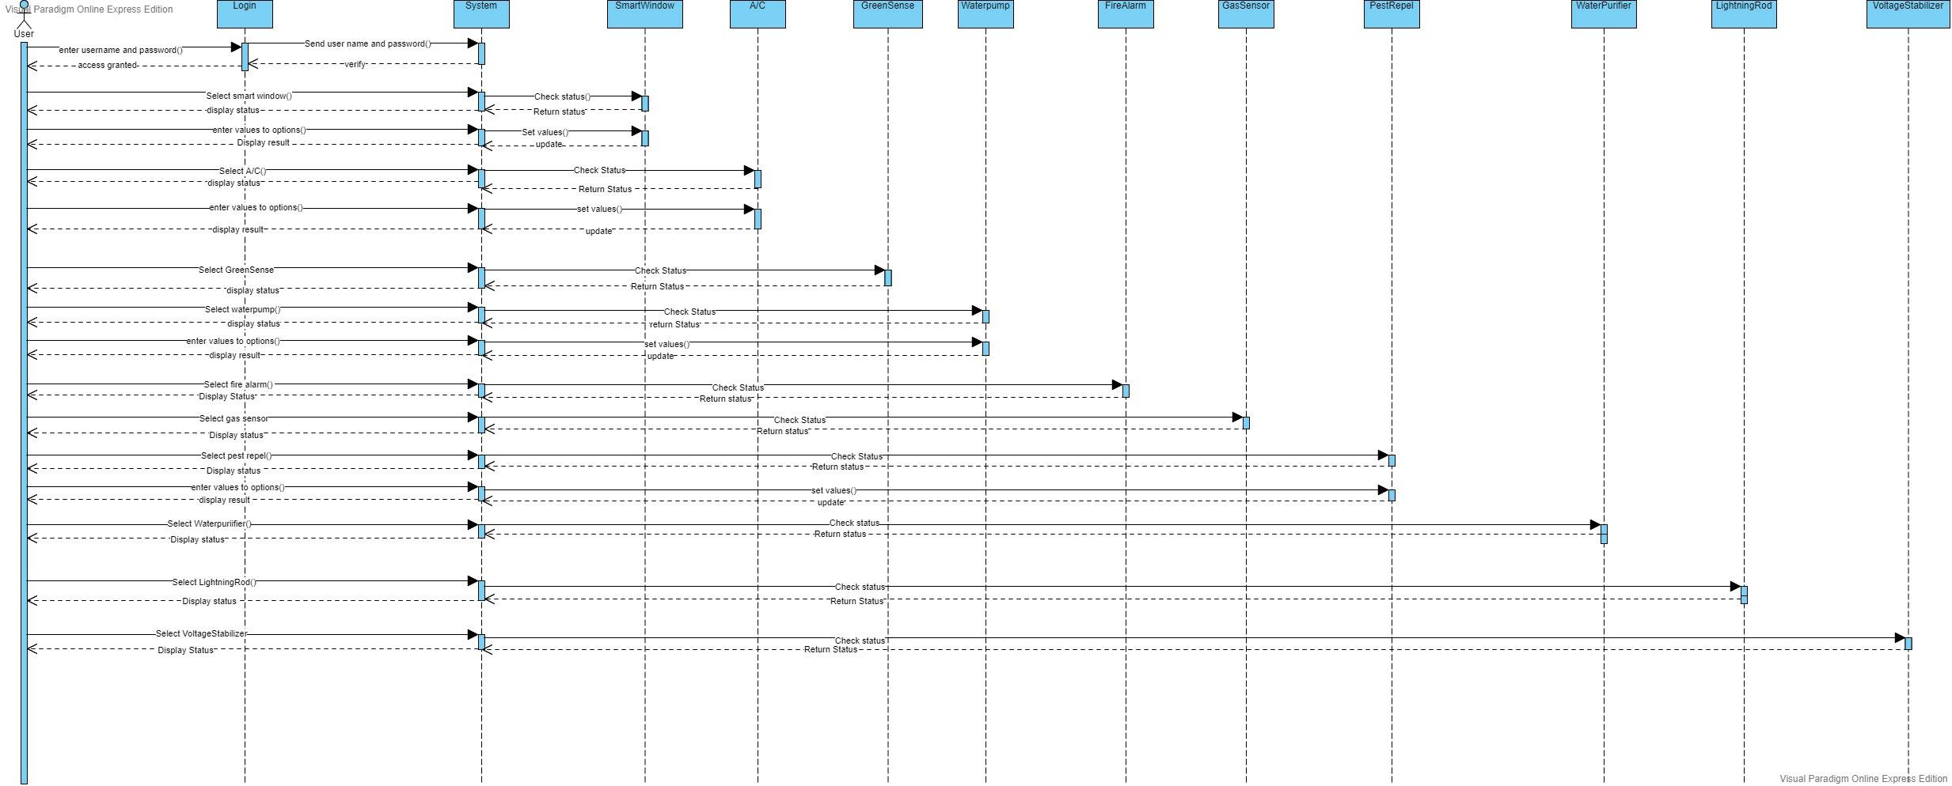

Slide 35
Thank you!

